Slide 1
Chongqing University of Technology
ATAI
^{Chongqing} Advanced Technique
University of of Artificial
_{Technology} Intelligence
Chongqing ^{ATAI}
Advanced
University of _{logy Technique of}
Technology
Chongqing University of Technology
Chongqing University of Techno
Intelligence
MmAP : Multi-modal Alignment Prompt for Cross-domain Multi-task Learning
https://github.com/CZ-TAO12/DisenIDP
—— AAAI 2024
Reported by Yuyang Lai
1

Slide 2
Chongqing University of Technology
ATAI
^{Chongqing} Advanced Technique
University of of Artificial
_{Technology} Intelligence
Chongqing
C^{U}ho^{n}n^{i}g^{v}q^{e}in^{r}g^{s}U^{it}n^{y}iveºr^{f}sity of Technollooggyy
Technology
Chongqing University of Techno
f
Intelligence
1.Introduction 2.Method
3.
2

Slide 3
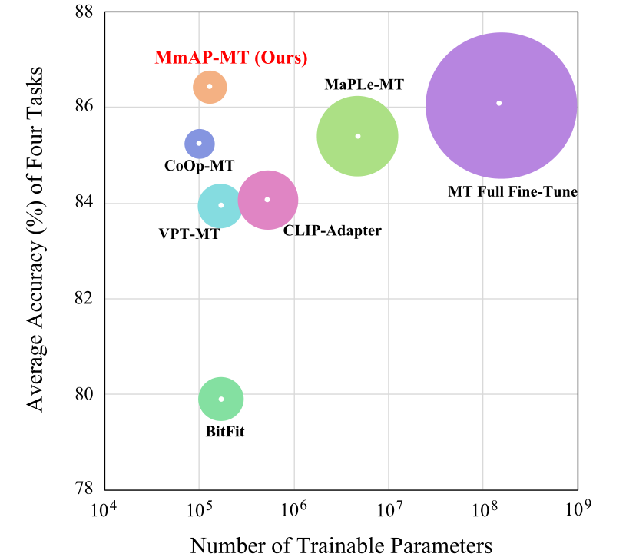
ATAI
^{Chongqing} Advanced Technique
University of of Artificial
Intelligence
Chongqing University of Technology
Typically, a multi-task network structure consists of a shared backbone and task-specific decoders. However, the complexity of the decoders increases with the number of tasks. To tackle this challenge, we integrate the decoder-free vision-language model CLIP, which exhibits robust zero-shot generalization capability.

Slide 4
ATAI
^{Chongqing} Advanced Technique
University of of Artificial
Intelligence
Chongqing University of Technology
Recently,parameter-efficient transfer learning methods have been extensively explored with CLIP for adapting to downstream tasks, where prompt tuning showcases strong potential. Nevertheless, these methods solely fine-tune a single modality(text or visual), disrupting the modality structure of CLIP.

Slide 5
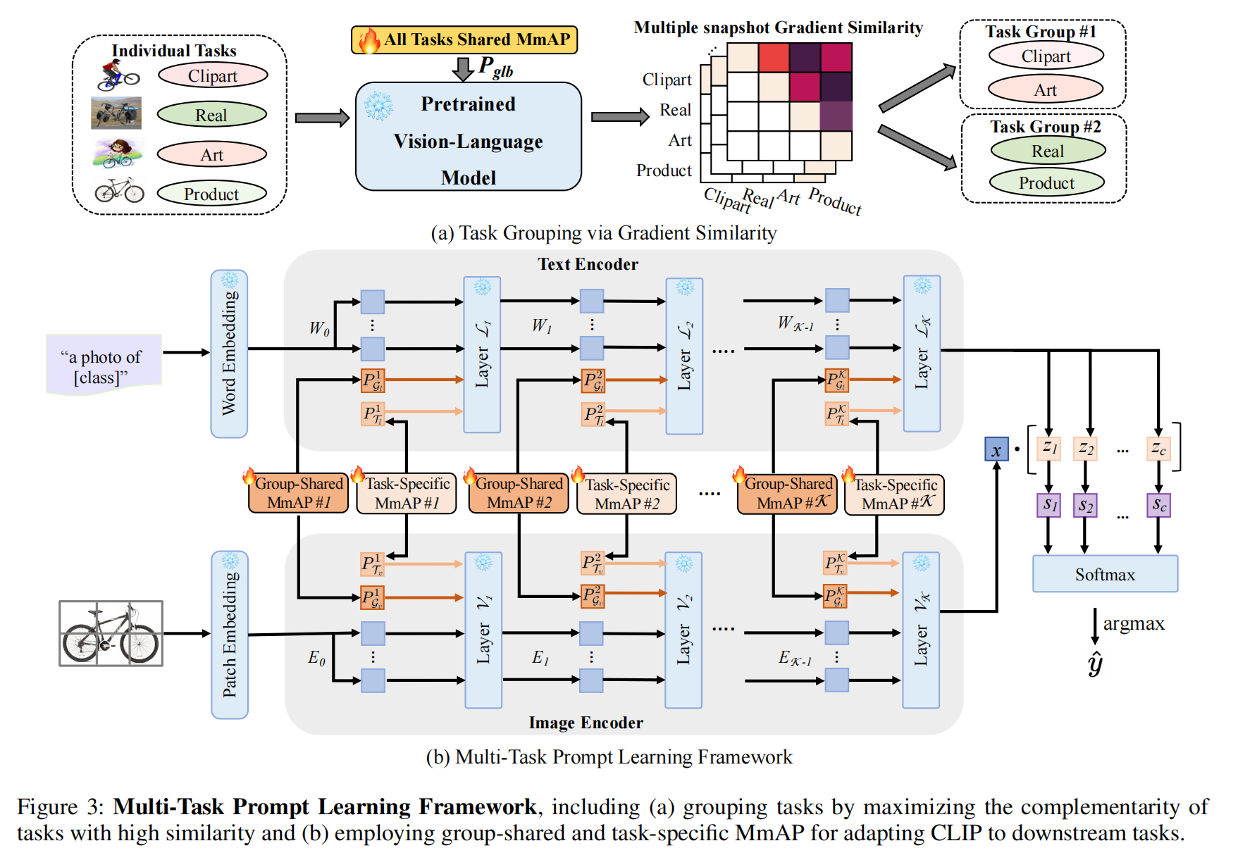
ATAI
ATAI
^{Chongqing} Advanced Technique
University of of Artificial
Intelligence
Chongqing University of Technology
Advanced Technique
of Artificial Intelligence

Slide 6
ATAI
ATAI
^{Chongqing} Advanced Technique
University of of Artificial
Intelligence
Chongqing University of Technology
Advanced Technique
of Artificial Intelligence

Slide 7
ATAI
ATAI
^{Chongqing} Advanced Technique
University of of Artificial
Intelligence
Chongqing University of Technology
Advanced Technique
of Artificial Intelligence

Slide 8
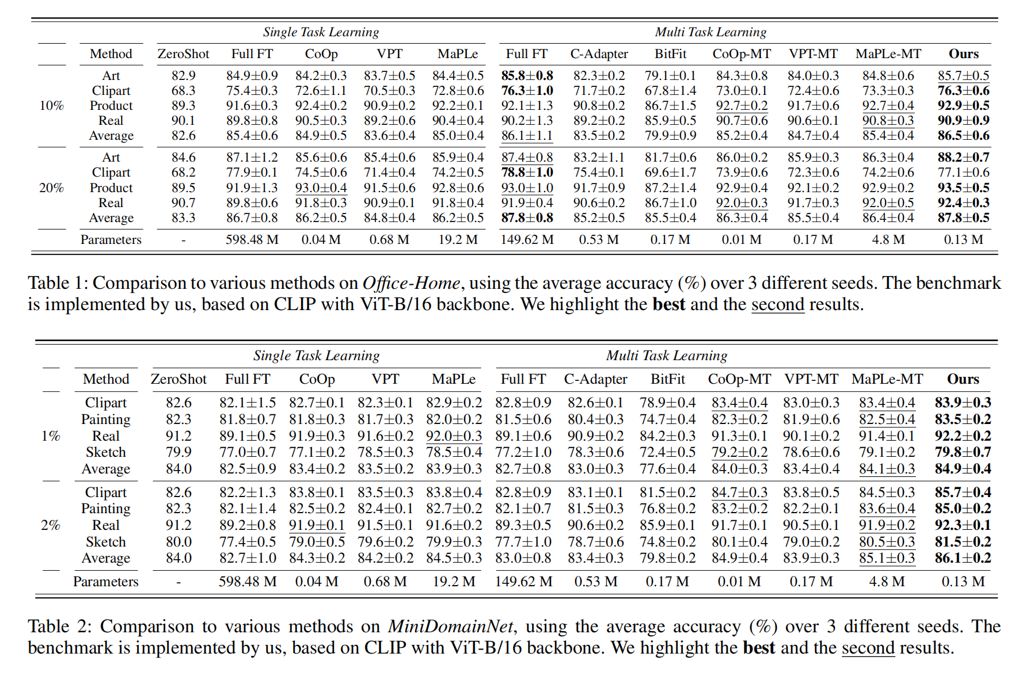
ATAI
ATAI
^{Chongqing} Advanced Technique
University of of Artificial
Intelligence
Chongqing University of Technology
Advanced Technique
of Artificial Intelligence

Slide 9
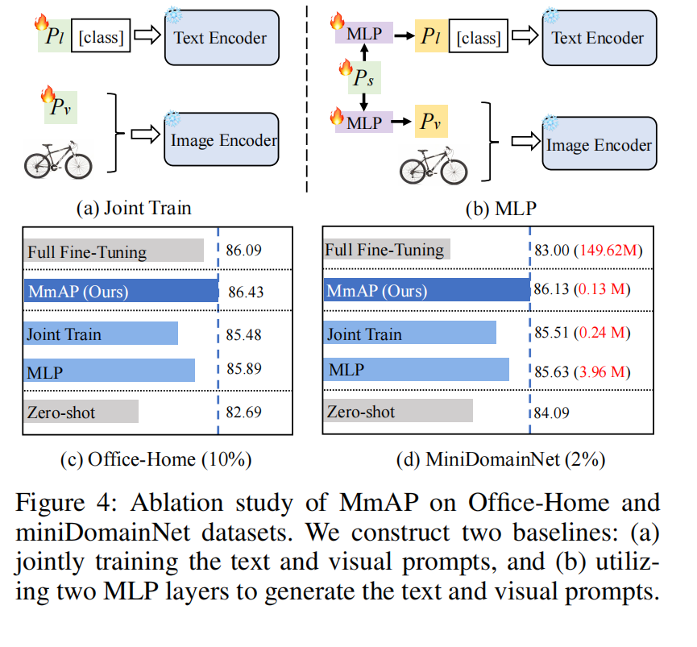
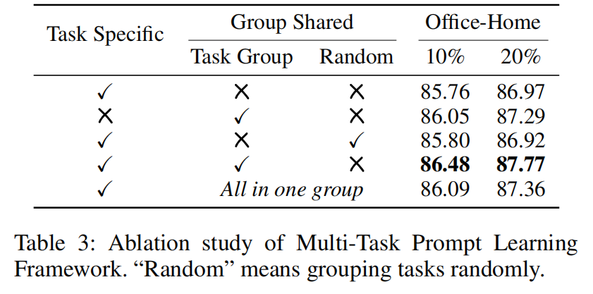
ATAI
ATAI
^{Chongqing} Advanced Technique
University of of Artificial
Intelligence
Chongqing University of Technology
Advanced Technique
of Artificial Intelligence

Slide 10
ATAI
ATAI
^{Chongqing} Advanced Technique
University of of Artificial
Intelligence
Chongqing University of Technology
Advanced Technique
of Artificial Intelligence

